Slide 1
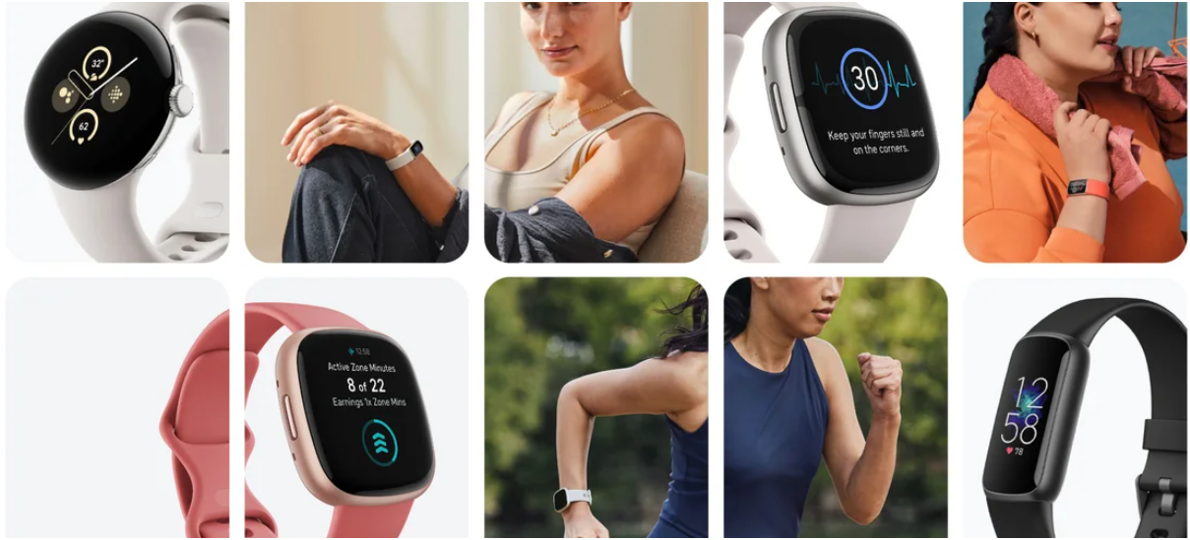
Fitbit Tracker Data Analysis
Created by Dinesh Kumar

Slide 2
Project Description
Exploring Fitbit's treasure trove of data from respondents via Amazon Mechanical Turk, spanning physical activity, heart rate, and sleep monitoring. With 19 datasets at hand, the challenge was on to unearth actionable insights!
Bussiness Tasks and Objectives
The mission? Delve deep into Fitbit Fitness Tracker App data to decode consumer behavior, uncover trends, and fuel marketing strategies. From identifying trends to influencing marketing tactics, it was all about driving impactful decisions.
Project Description
Python emerged as the superhero for data cleaning, transformation, visualization, and analysis, with Pandas Profiling lending a helping hand. From daily to hourly activities, sleep data to heart rate, each dataset was a goldmine waiting to be explored!

Slide 3
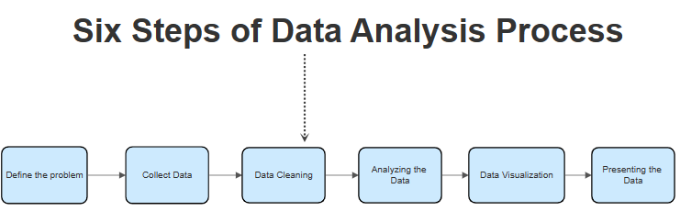
Timeline

Slide 4
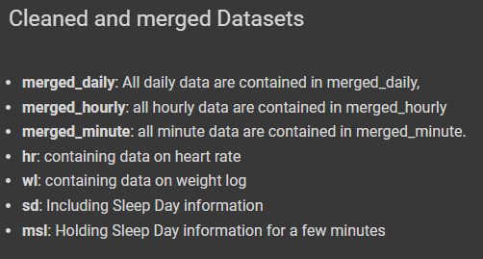
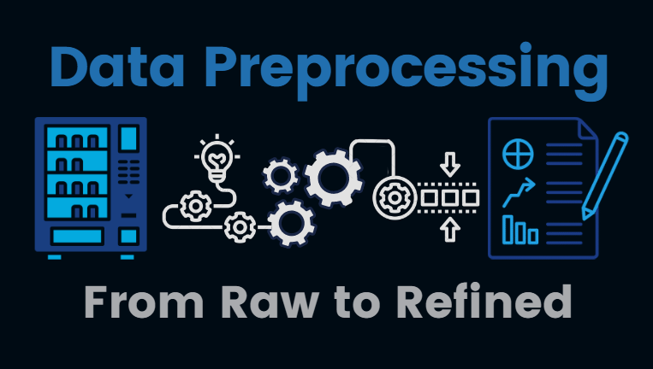
Data Preprocessing

Slide 5
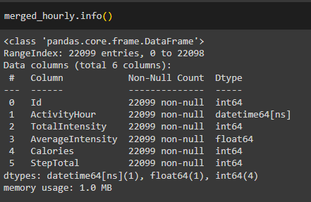
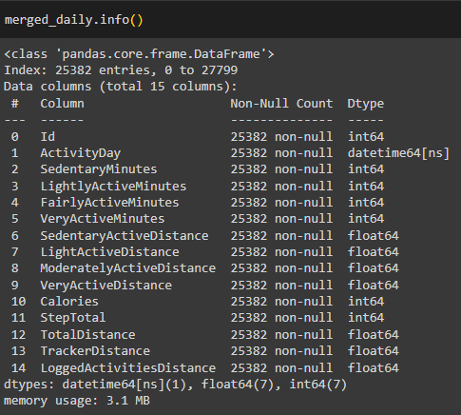
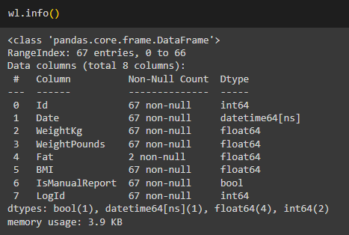
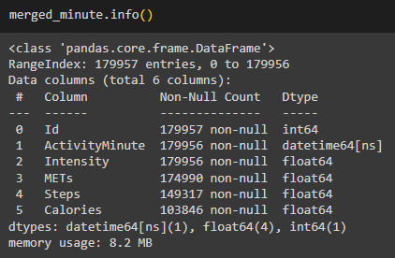
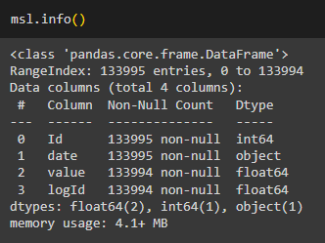
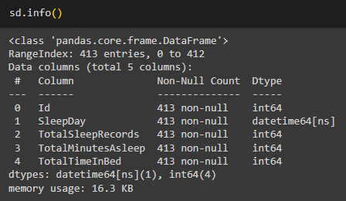
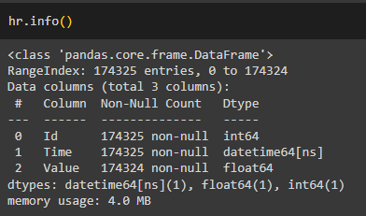
Info about cleaned Datasets

Slide 6
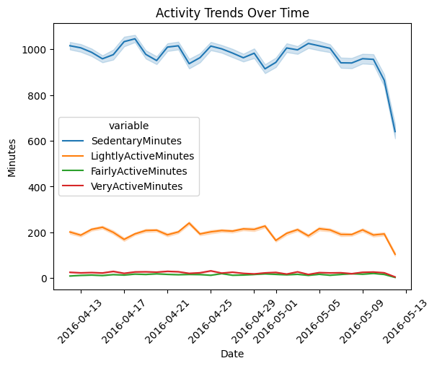
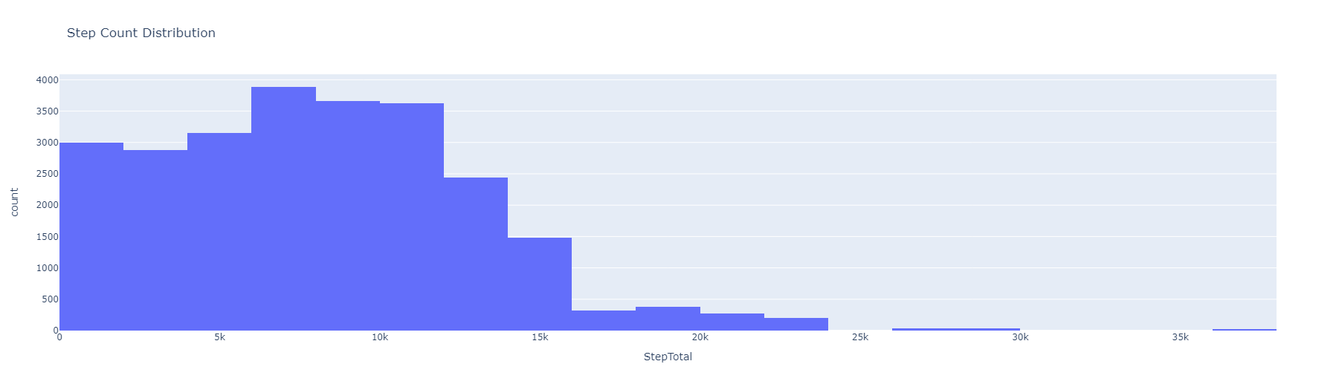
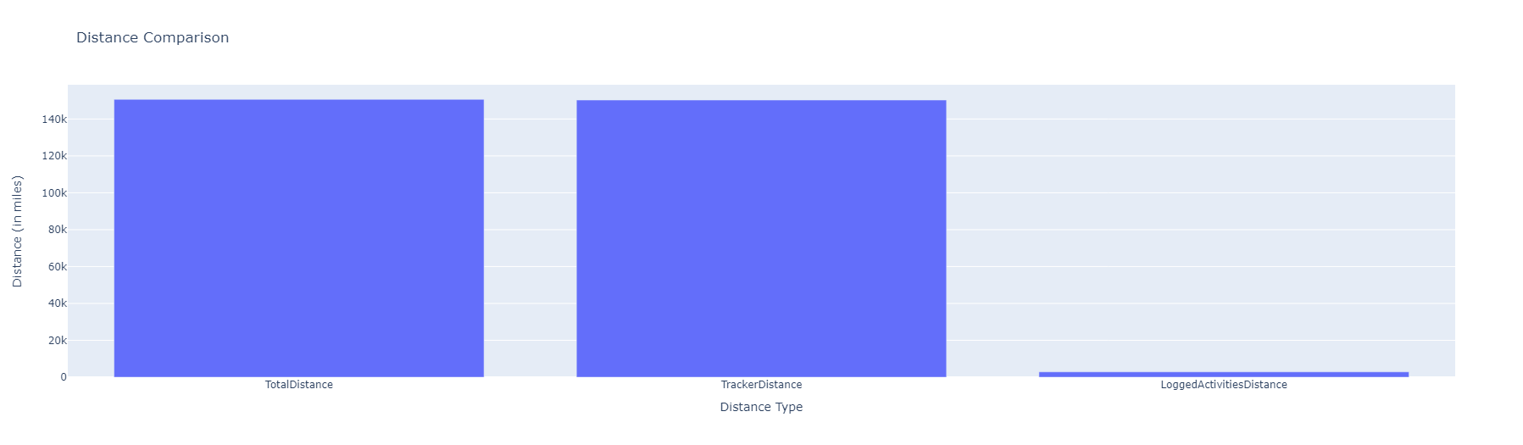
Daily Dataset

Slide 7
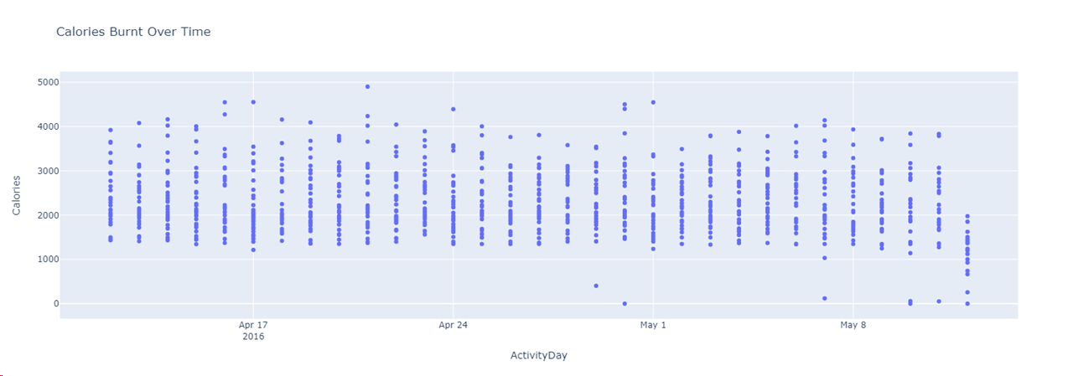
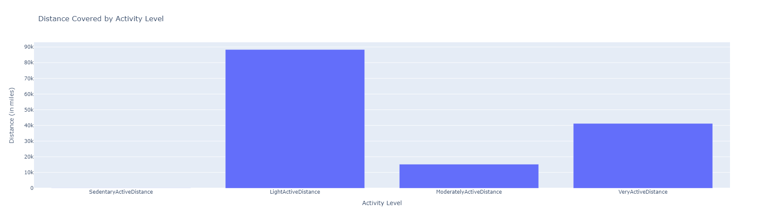

Slide 8
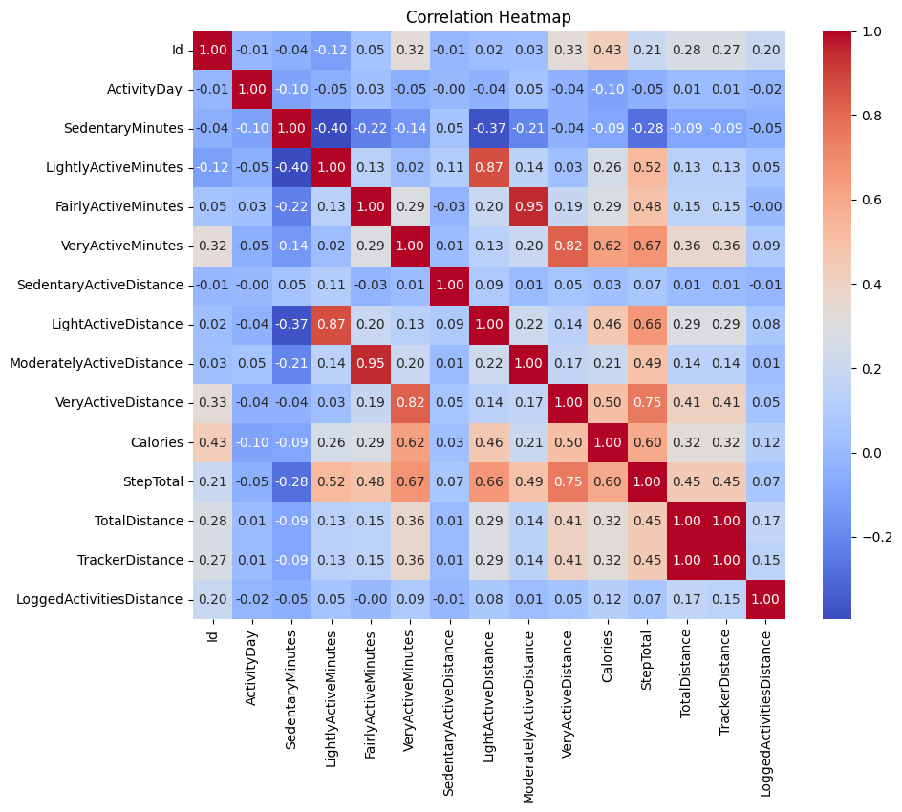
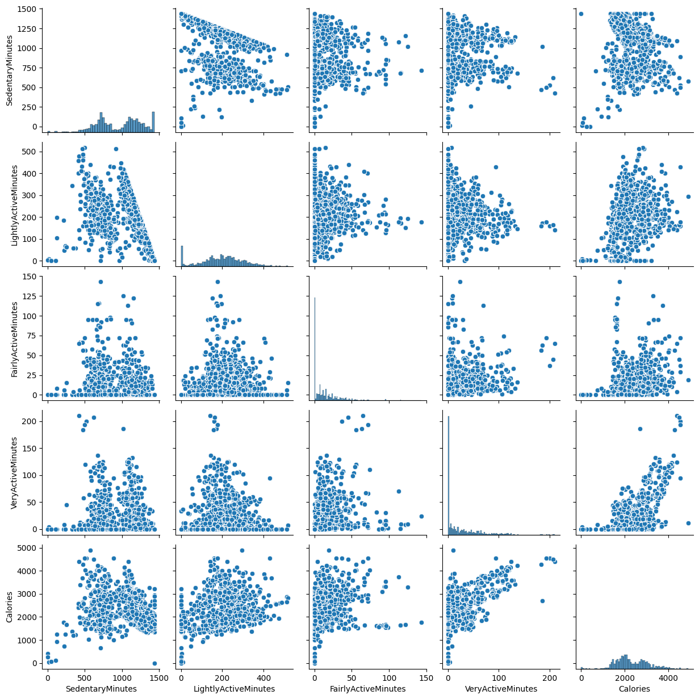

Slide 9
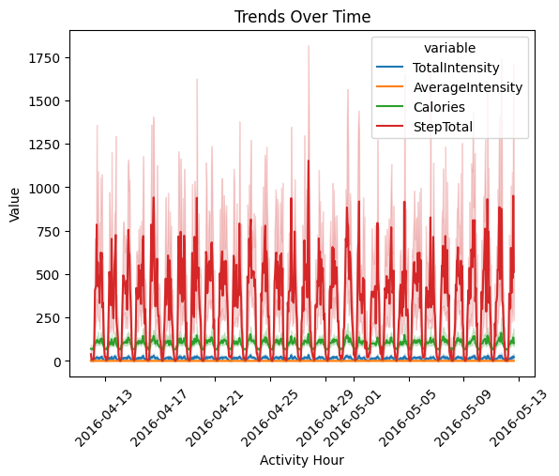
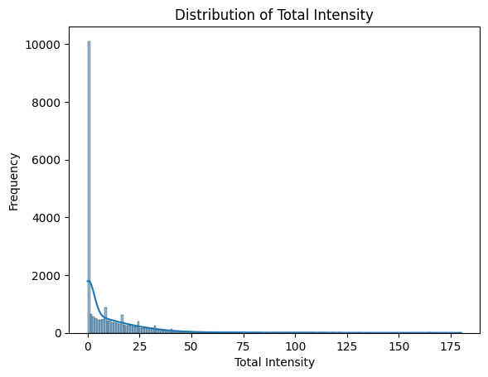
Hourly Dataset

Slide 10
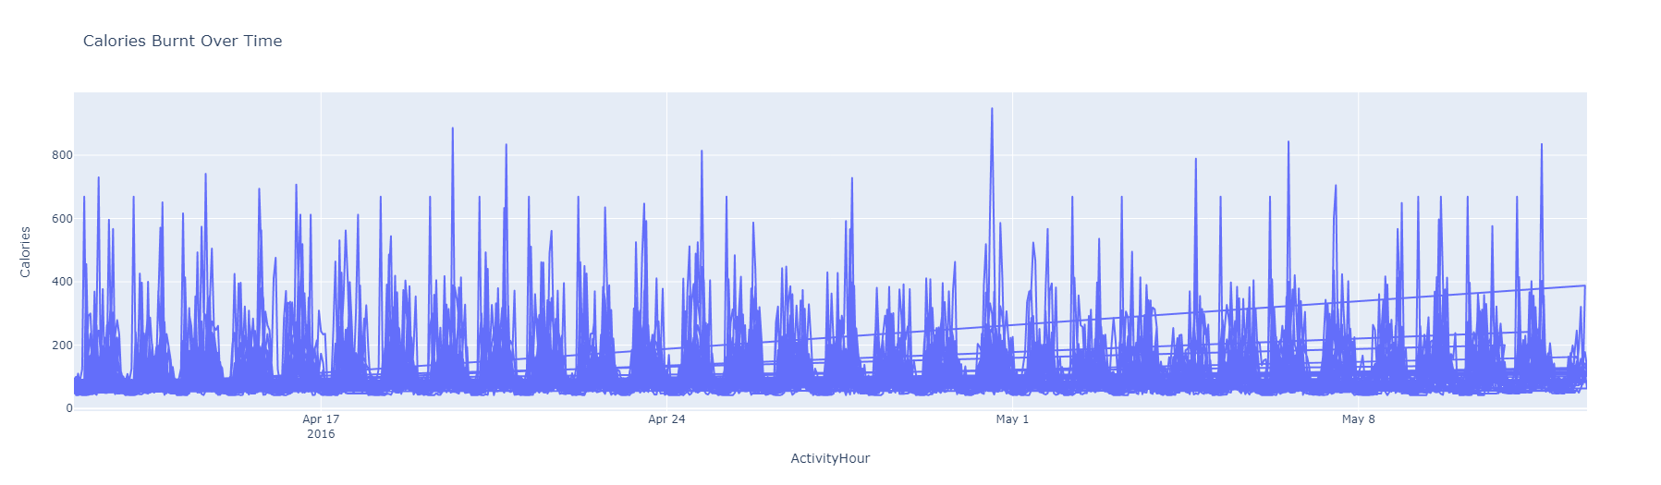
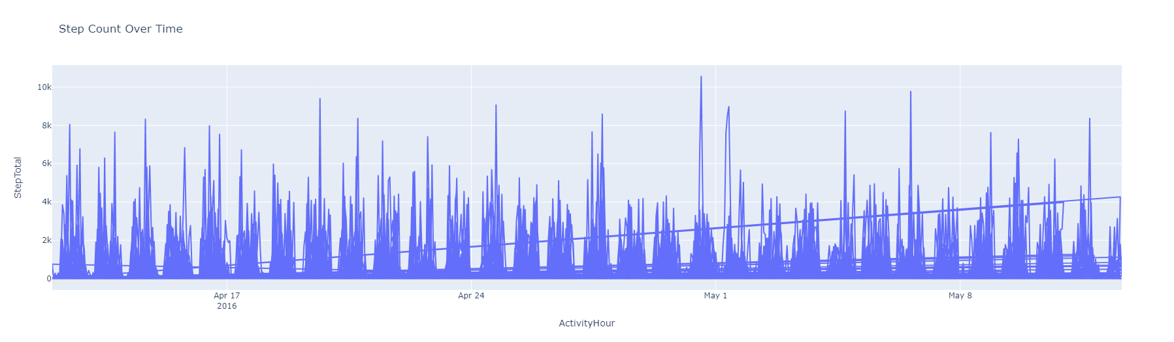

Slide 11
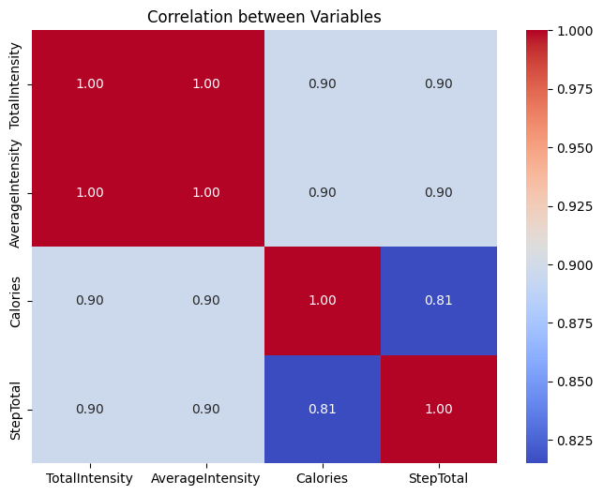

Slide 12
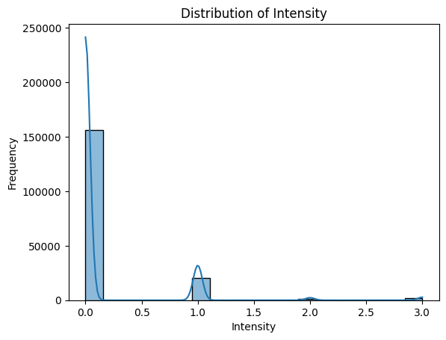
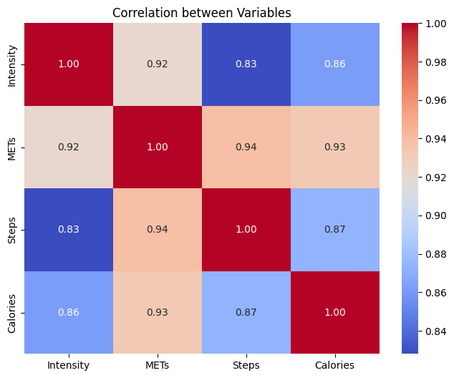
Minutes Dataset

Slide 13
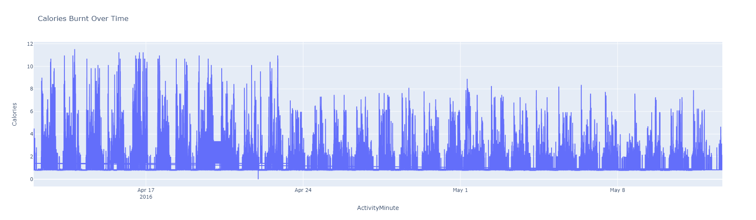
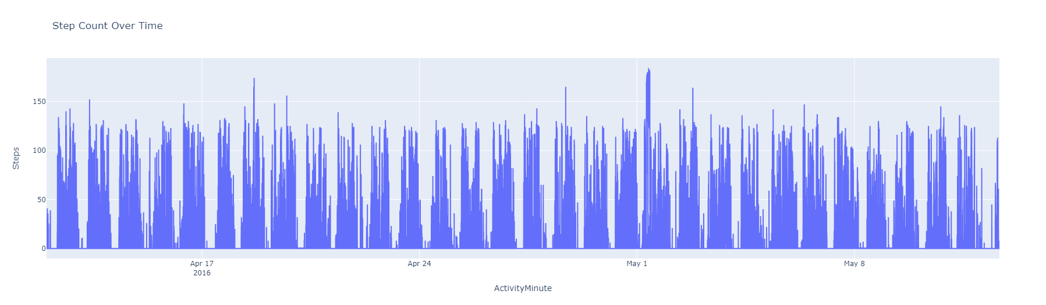

Slide 14
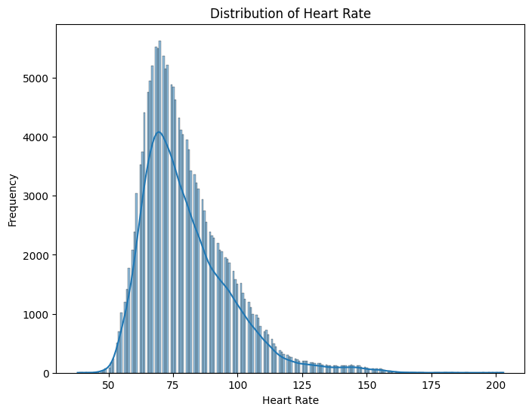
Heart Rate Dataset

Slide 15
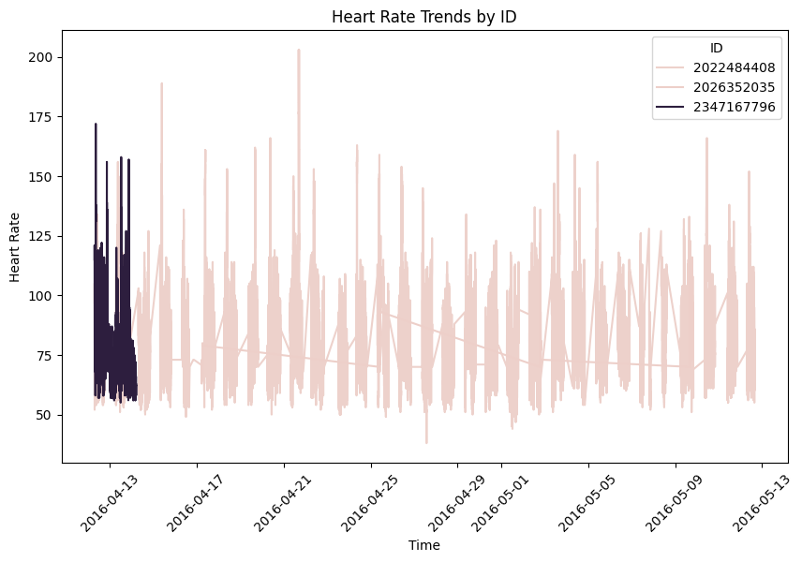

Slide 16
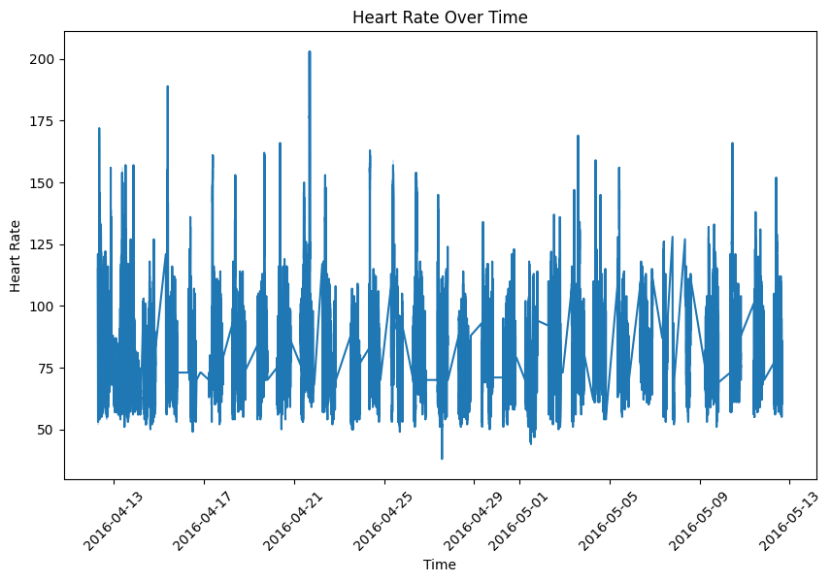

Slide 17
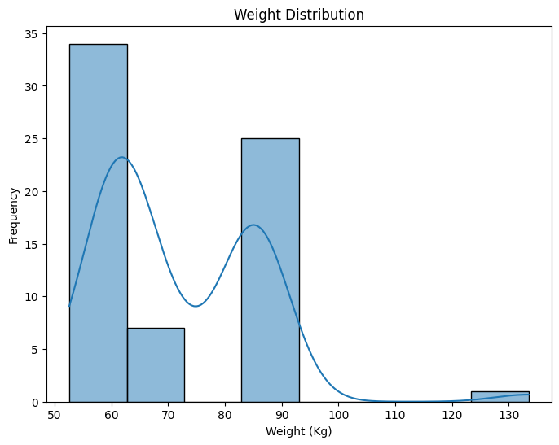
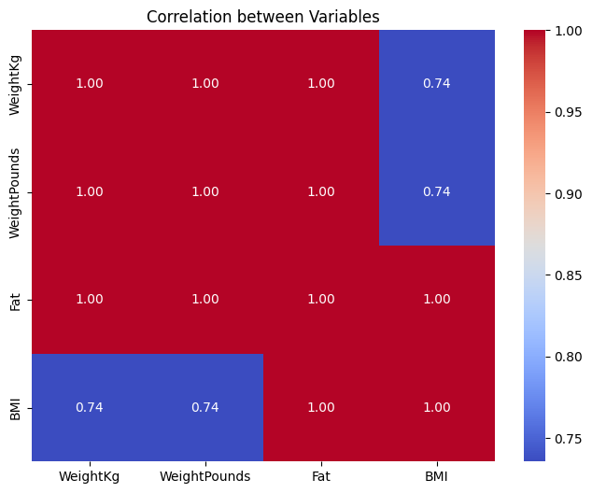
Weight Log Dataset

Slide 18
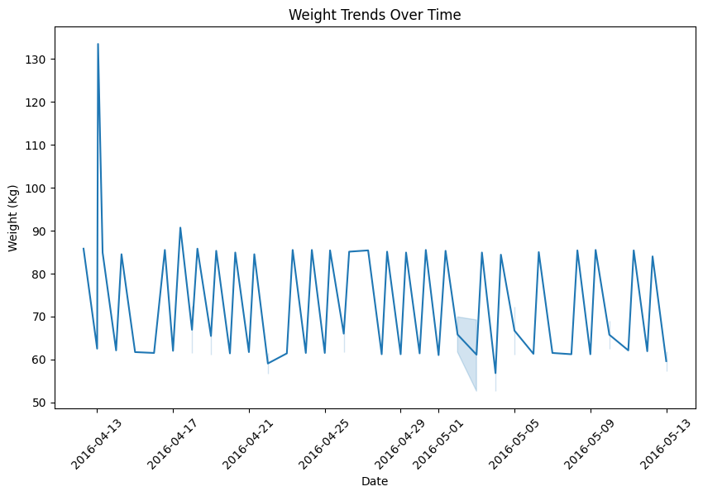
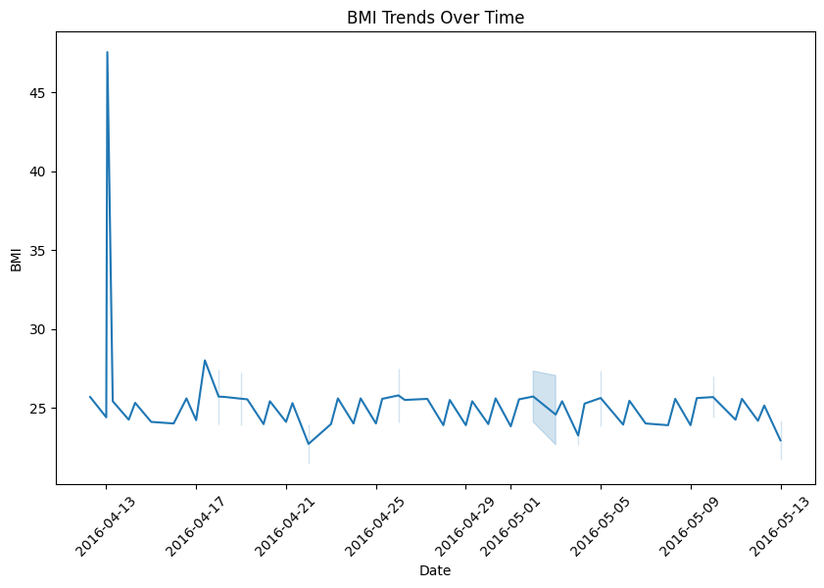

Slide 19
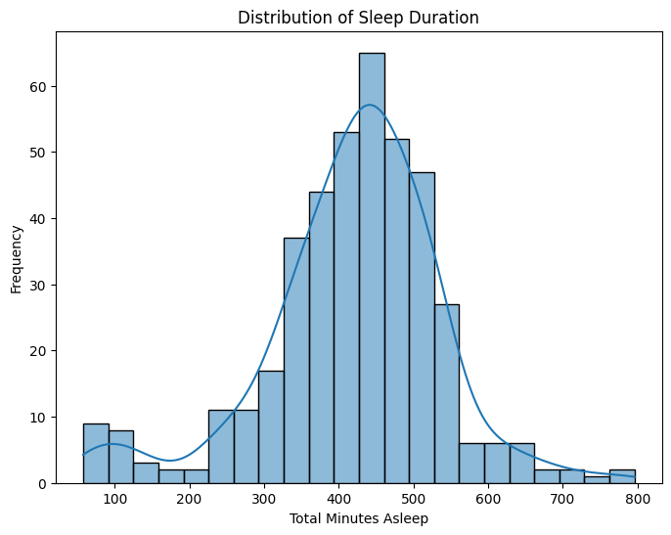
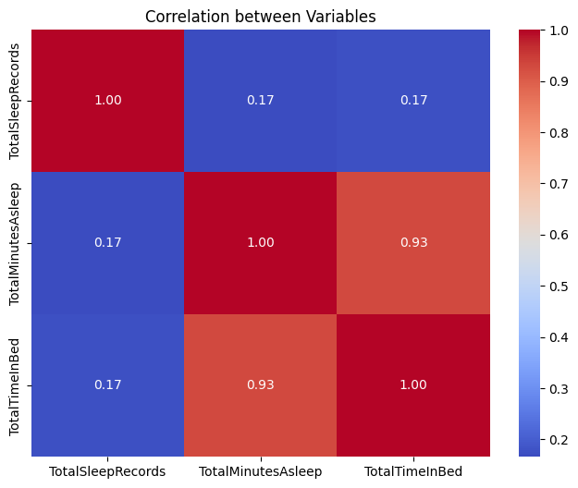
Sleep Day Dataset

Slide 20
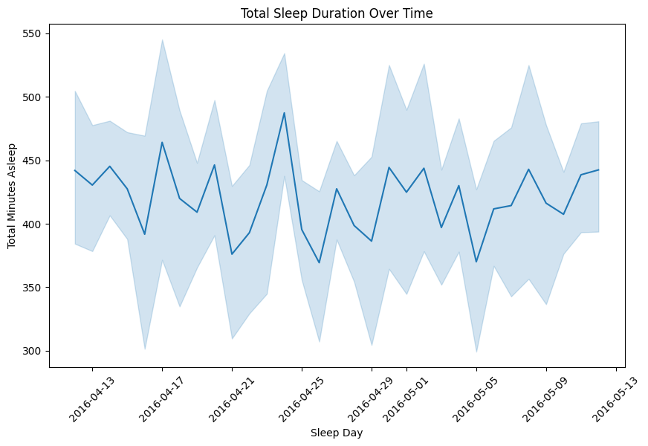
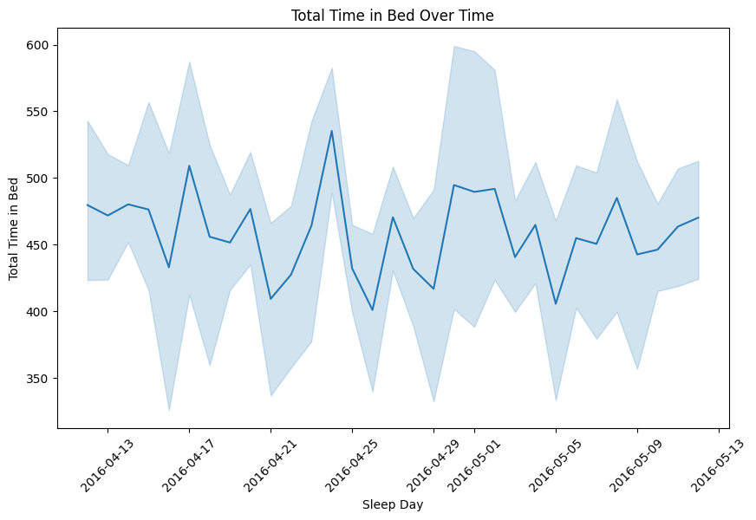

Slide 21
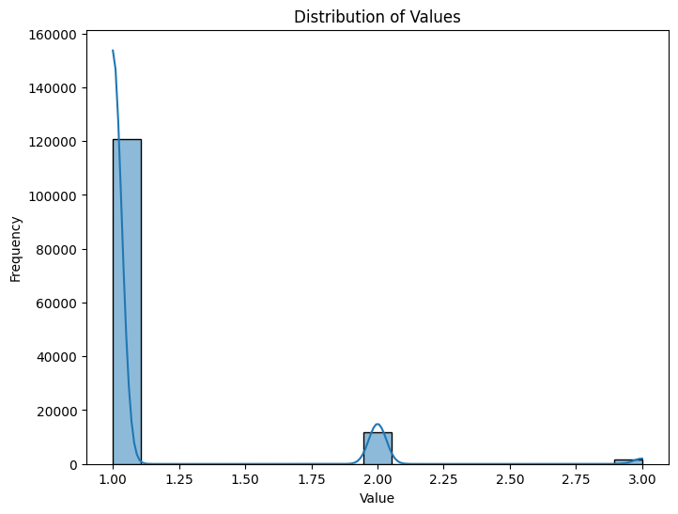
Holding sleep day Dataset

Slide 22
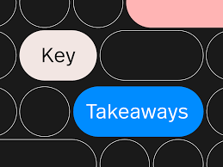
Key TakeawAYs
1️⃣Business Task Summary
2️⃣Description of Data Sources
3️⃣Documentation of Data Preprocessing
4️⃣Analysis Summary
5️⃣Supporting Visualizations & Key Findings
6️⃣High-Level Content Recommendations

